Slide 1


大模型系列 – 大模型算法
打破 Transformer
ZOMI

Slide 2
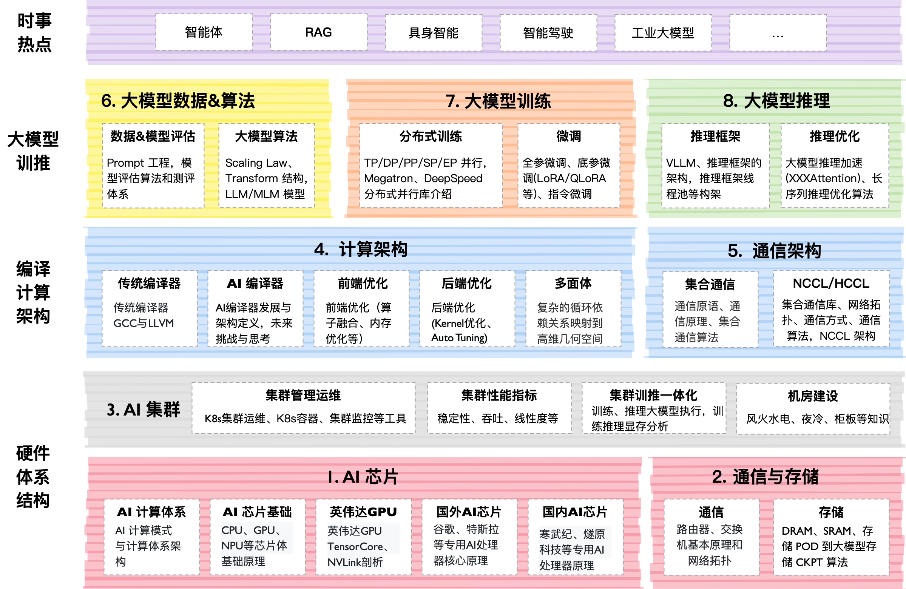

Slide 3
关于本内容
Transformer 结构回顾与挑战
Mamba 新结构
RWKV 新结构
未来打破 Transformer 的路在何方

Slide 4
01
Mamba

Slide 5
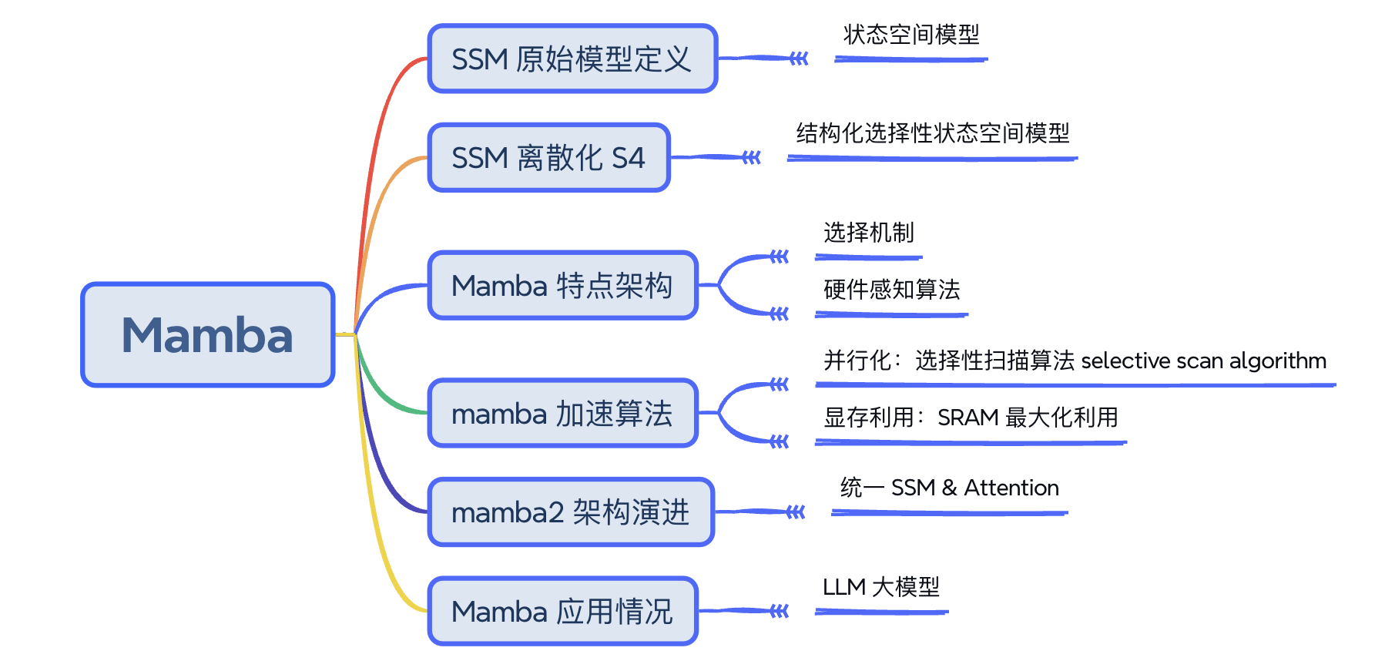
Mamba

Slide 6
Mamba

Slide 7
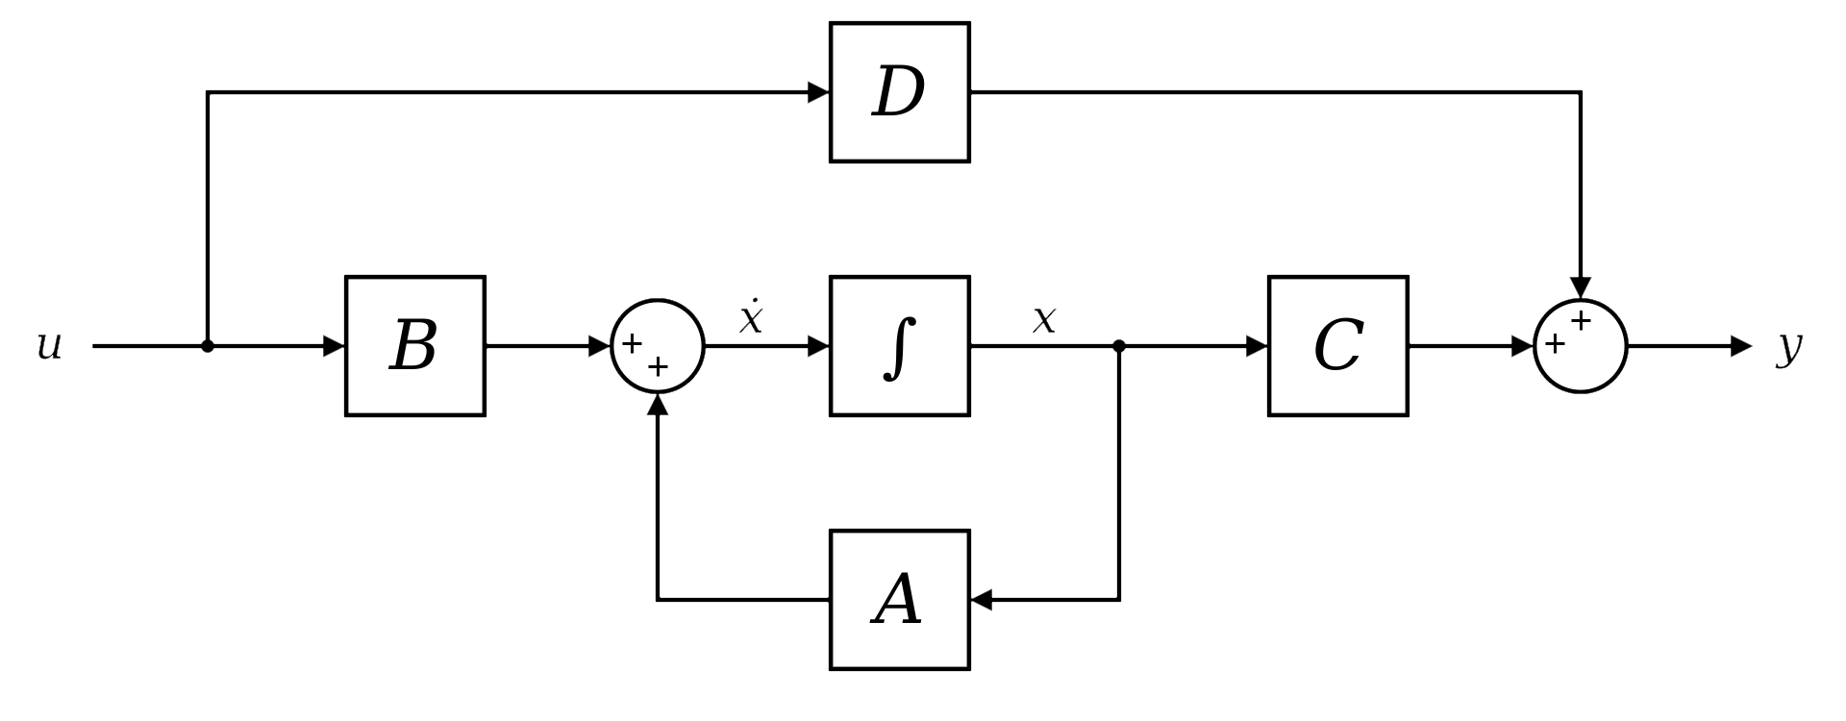
SSM
Intelligent Control Systems: An Introduction with Examples
State-space representation → State Space Model

Slide 8
Mamba

Slide 9
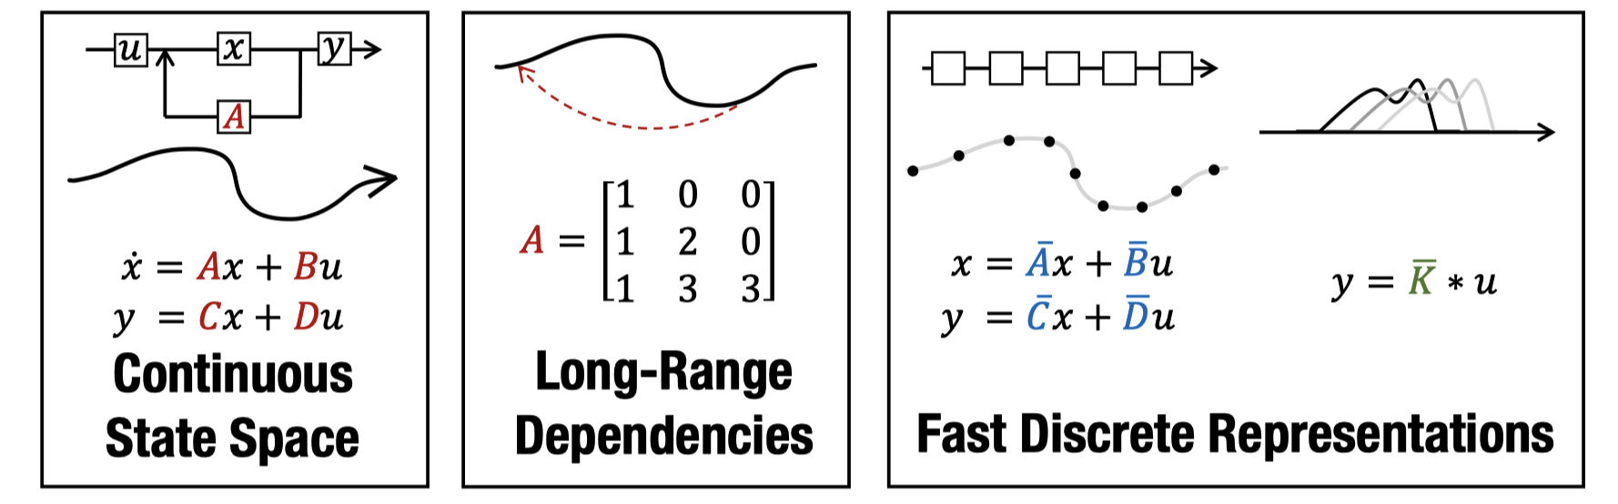
S4
Paper: Efficiently Modeling Long Sequences with Structured State Spaces
aka. Structured State Space sequence model (S4)

Slide 10
Mamba

Slide 11
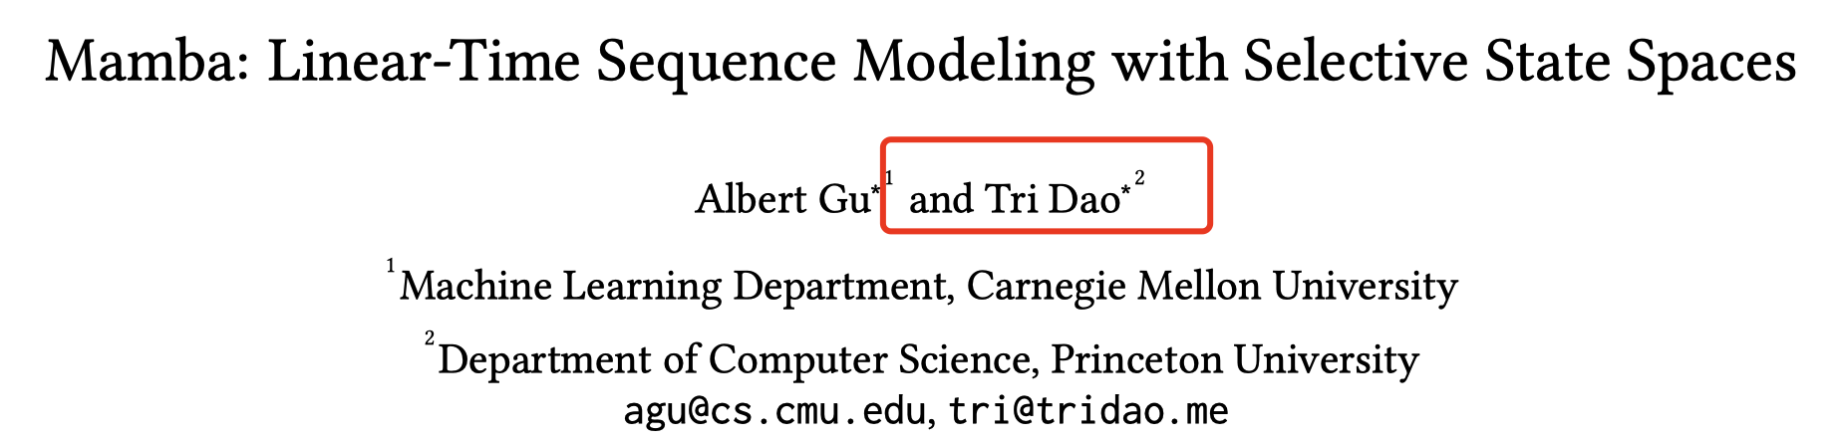
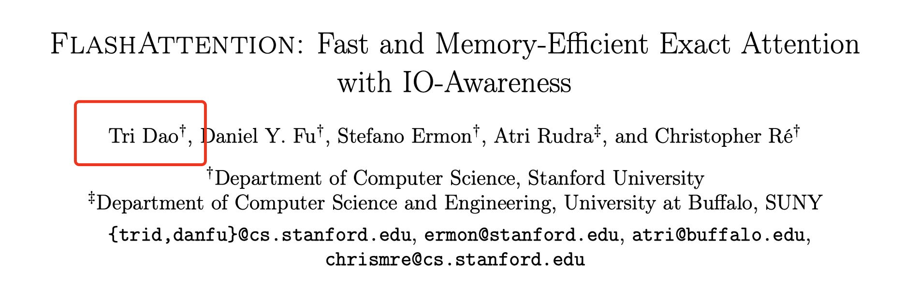
mamba

Slide 12
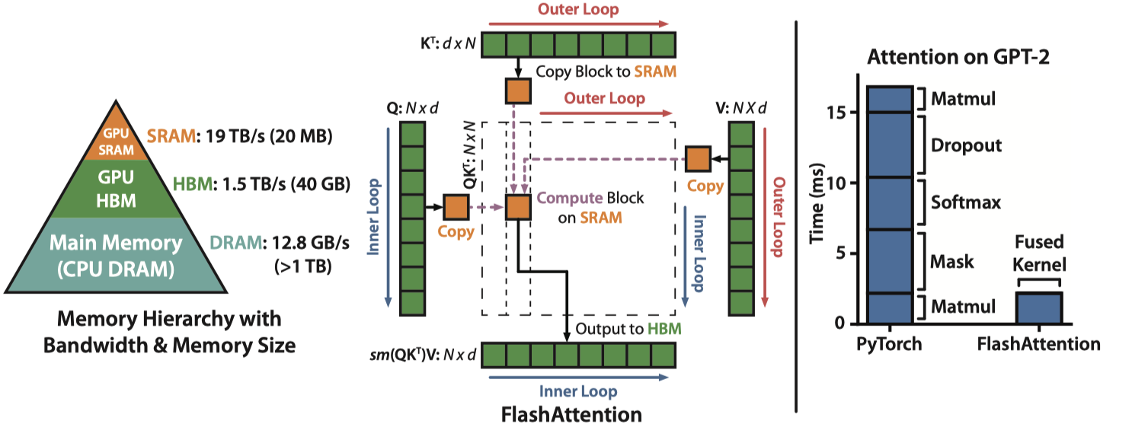
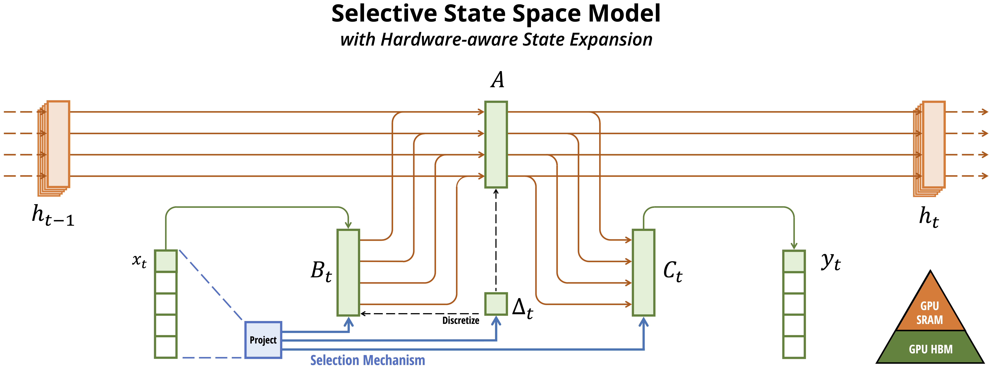
mamba

Slide 13
Mamba

Slide 14
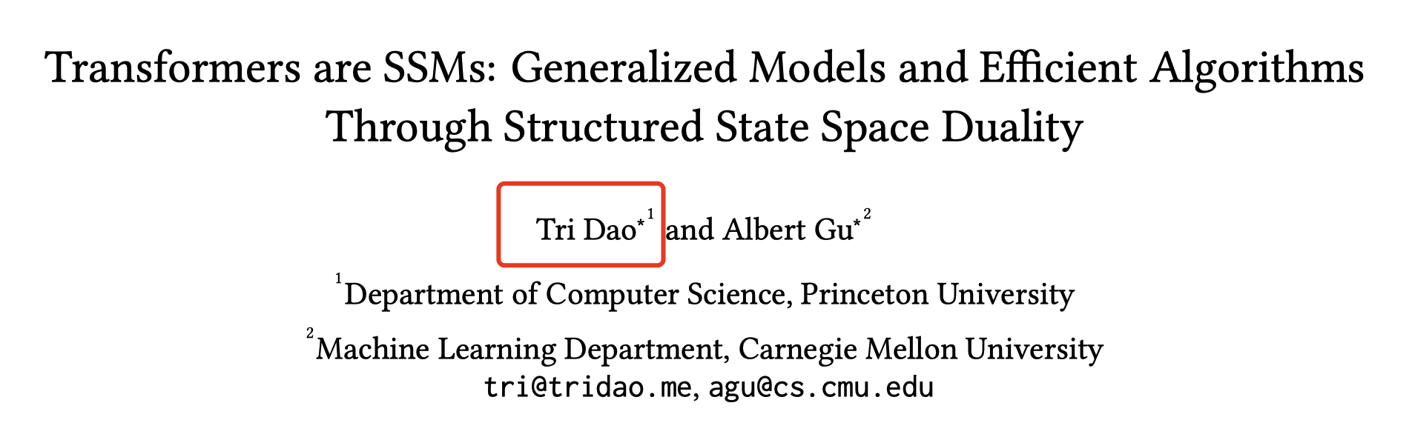
mamba2

Slide 15
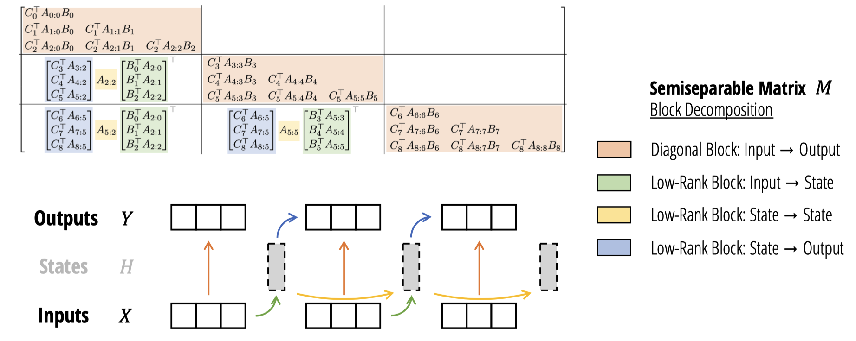
mamba2

Slide 16
Reference 参考&引用
https://srush.github.io/annotated-s4/
https://huggingface.co/blog/lbourdois/get-on-the-ssm-train
https://en.wikipedia.org/wiki/State-space_representation
https://arxiv.org/abs/2405.21060
https://github.com/state-spaces/mamba?tab=readme-ov-file

Slide 17
02
RWKV

Slide 18
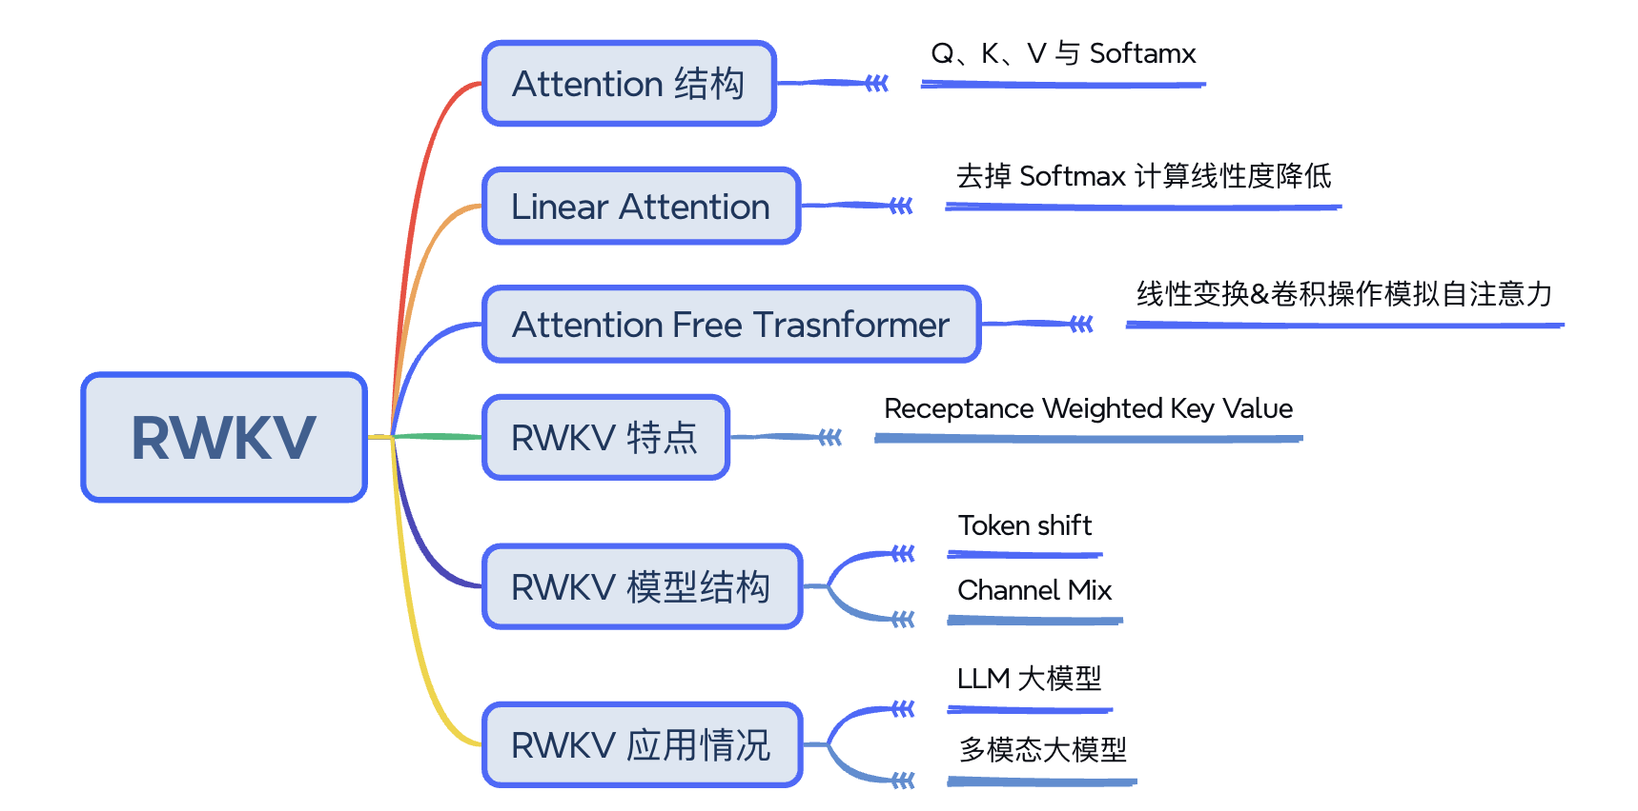
RWKV

Slide 19
RWKV

Slide 20
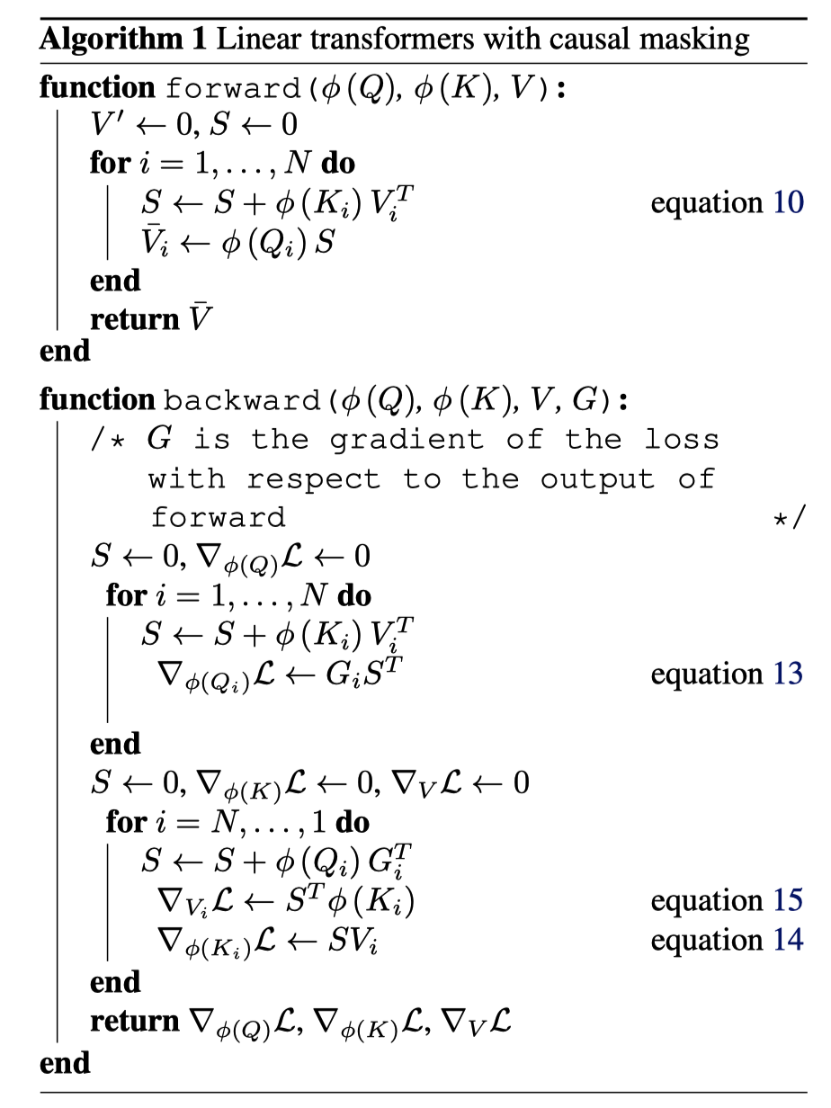
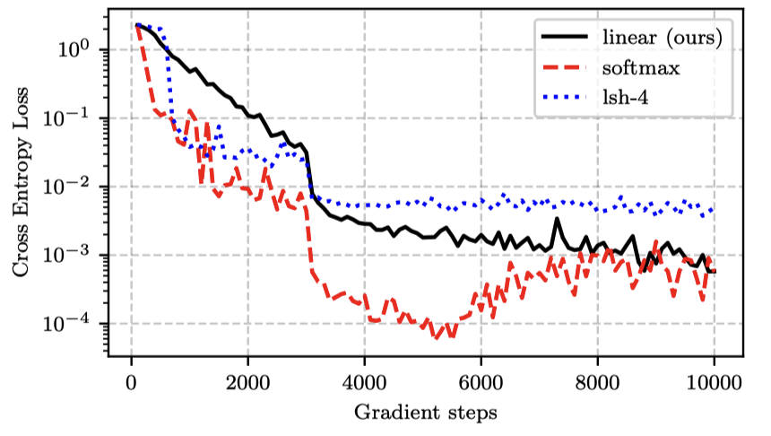
Linear Attention
Transformers are rnns: Fast autoregressive transformers with linear attention.

Slide 21
RWKV

Slide 22
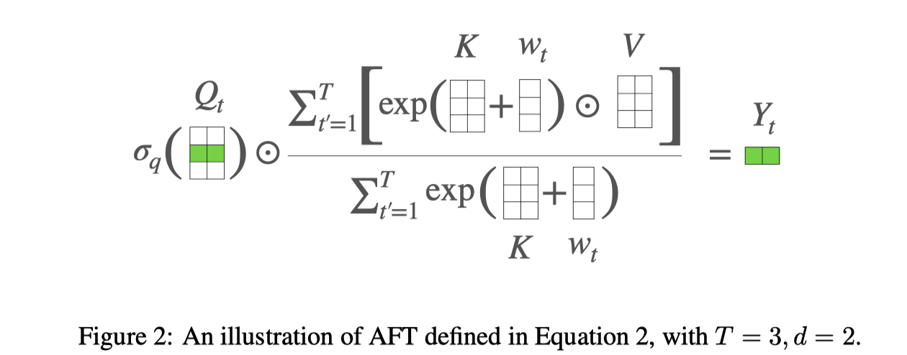
AFT
Paper：An attention free transformer.

Slide 23
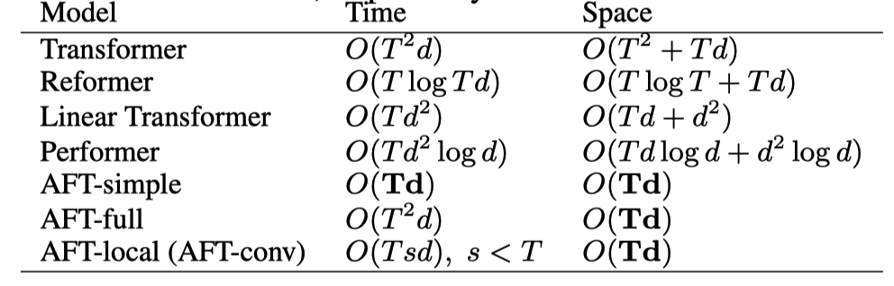
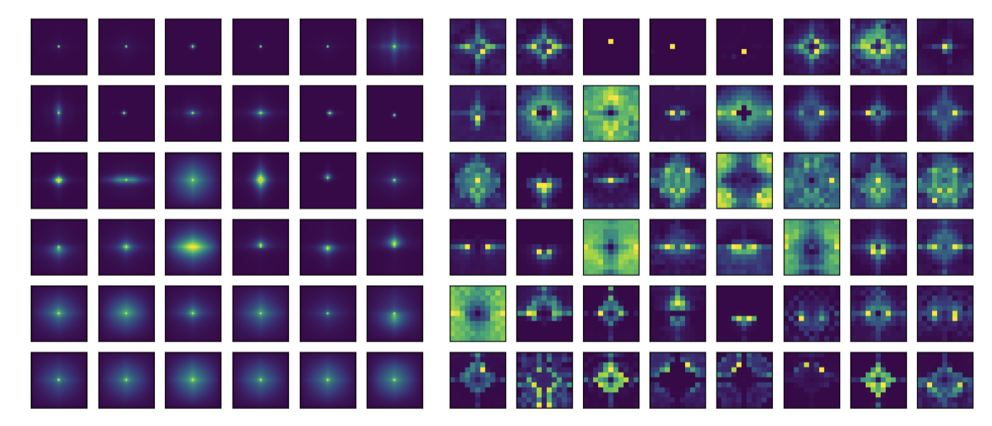
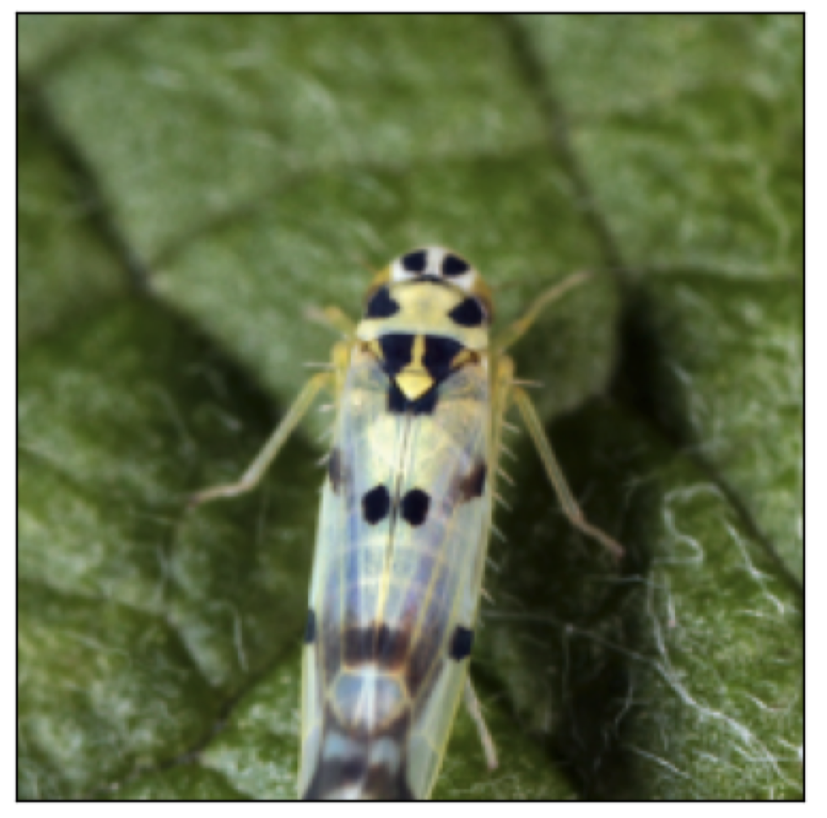
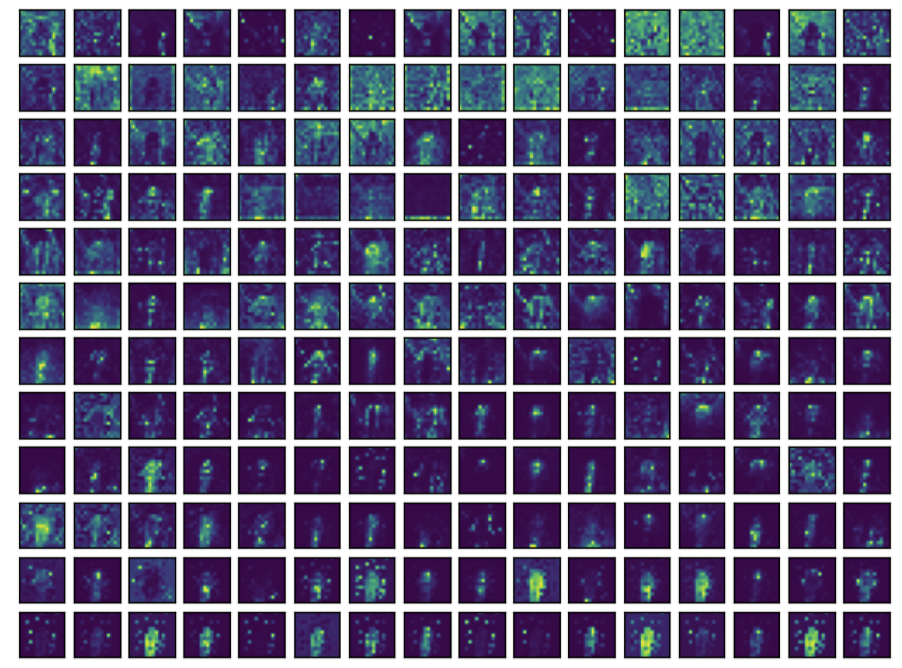
AFT
Paper：An attention free transformer.

Slide 24
RWKV

Slide 25
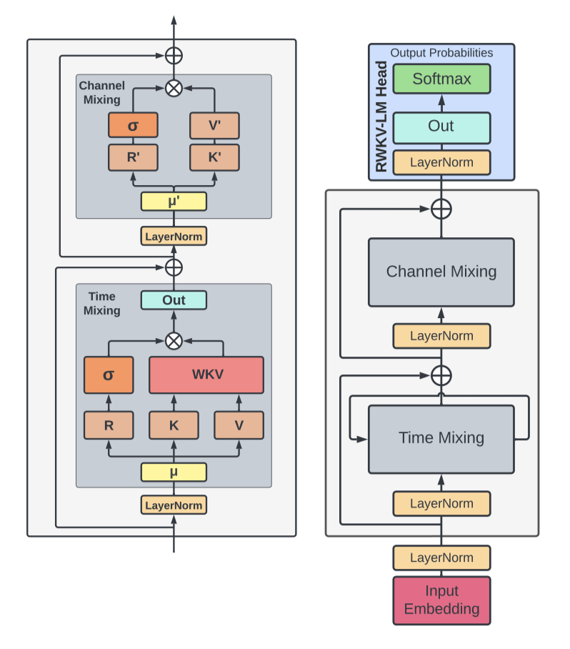
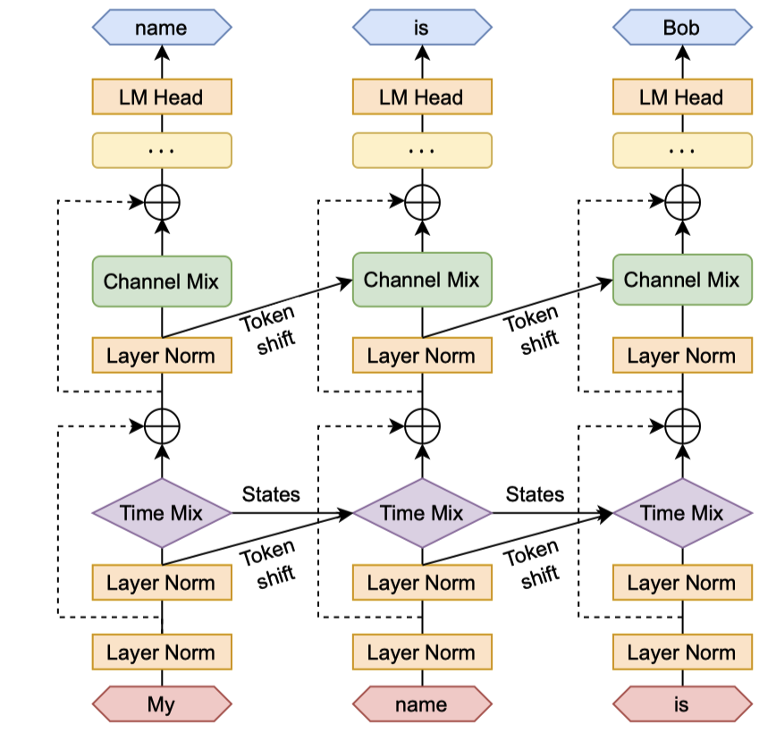
RWKV
RWKV: Reinventing RNNs for the Transformer Era

Slide 26
Reference 参考&引用
https://arxiv.org/abs/2006.16236
https://www.rwkv.com/
https://arxiv.org/abs/2105.14103
https://github.com/BlinkDL/RWKV-LM
https://wiki.rwkv.com/

